Slide 1
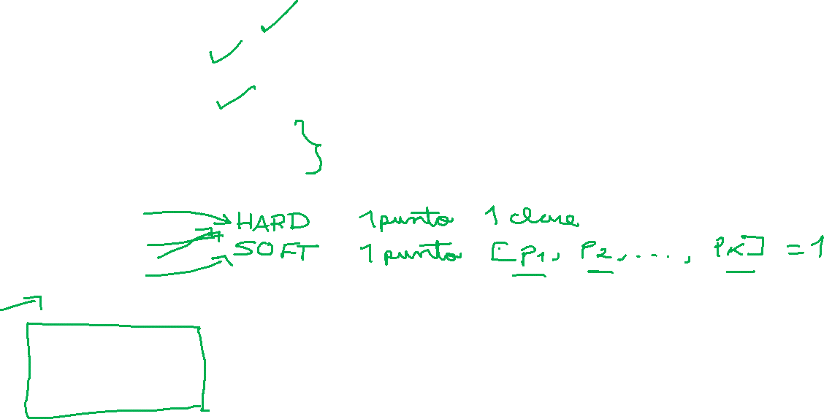
Machine Learning
Gradient Descent Algorithm
Linear Regression
Non-Linear Regression
Logistic Regression
Decision Trees
Regression Trees
Classification Trees
Model complexity and ensemble models
Clustering Algorithms
K-Means
Hierarchical clustering
DB-Scan
Mean Shift
GMM
Support Vector Machine
Deep Learning
MLP
CNN
Datasets
Breast Cancer Wisconsin
MIMIC-III
Framingham Heart Study
Alzheimer’s Disease Neuroimaging Initiative
Drug discovery
Microbiome

Slide 2
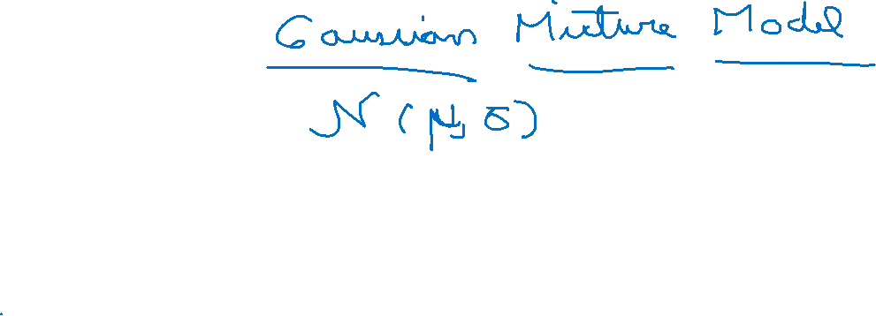
C8 – GMM
my humble ML course

Slide 3
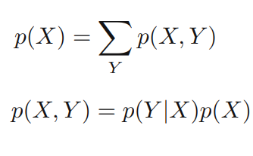
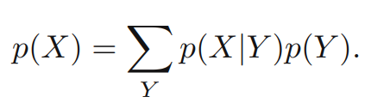
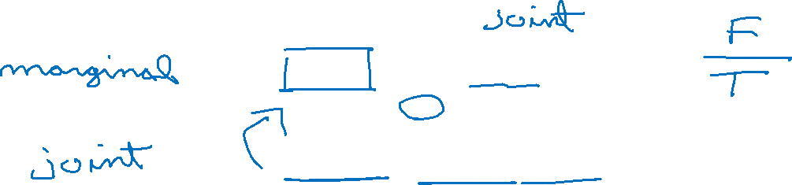
my humble ML course
Probability basics (sum and product rule)
Discrete:
Suppose 2 random variables X, Y

Slide 4
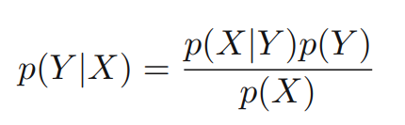
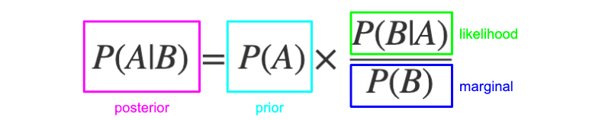
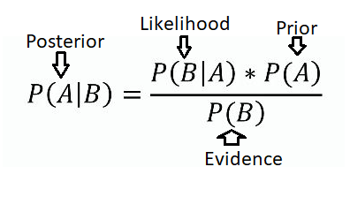
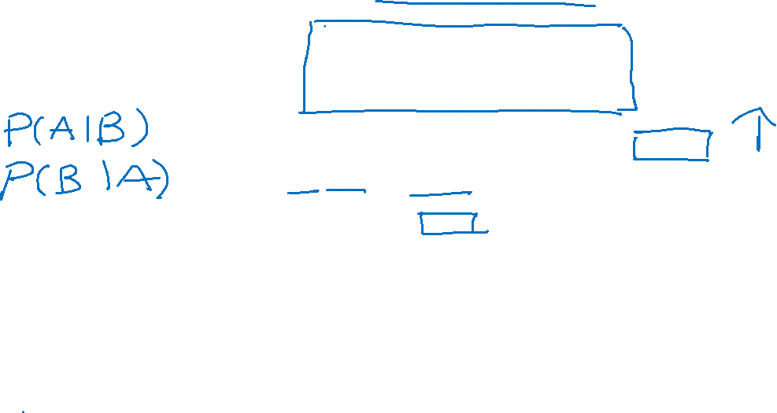
my humble ML course
Probability overview (Bayes’ rule)
<img>
Notes:
https://www.freecodecamp.org/news/bayes-rule-explained/

Slide 5
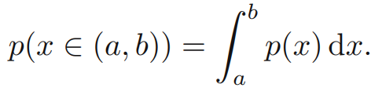
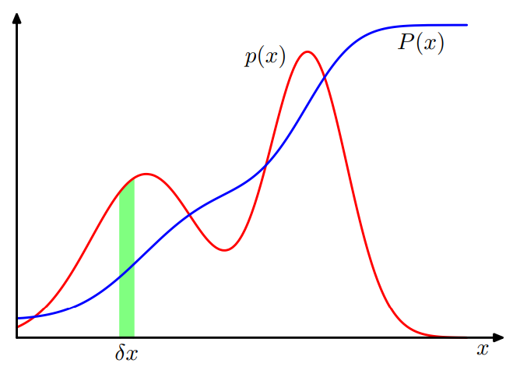
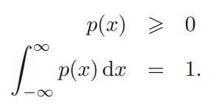
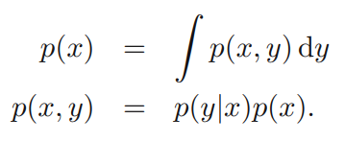
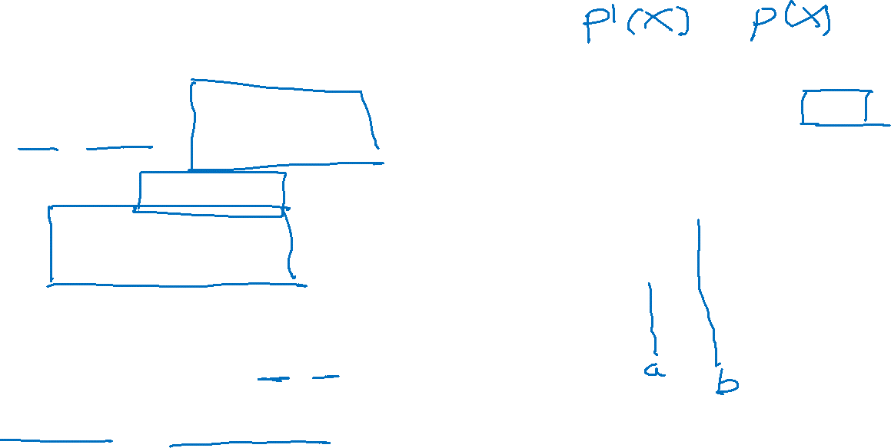
my humble ML course
Probability densities
Continuous space

Slide 6
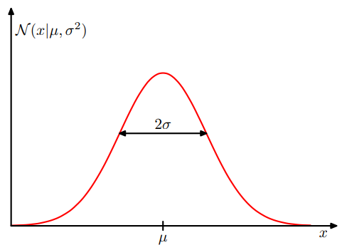
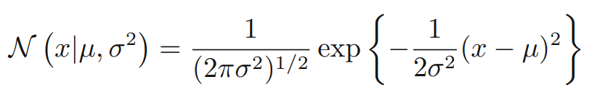
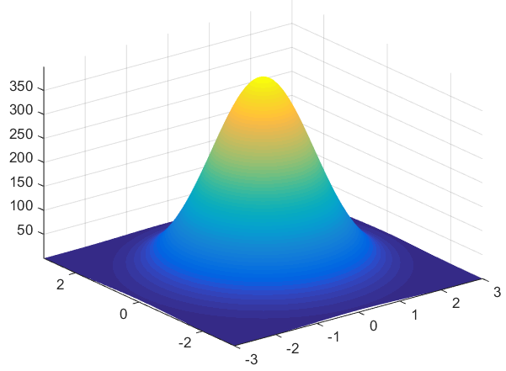
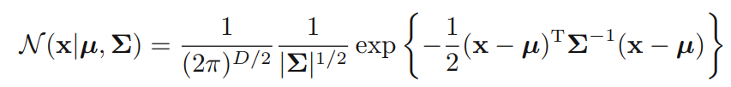
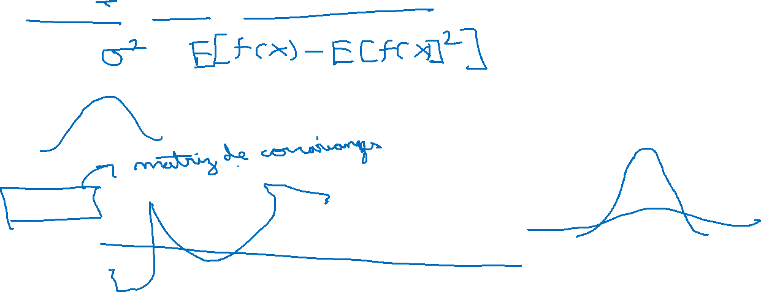
my humble ML course
Gaussian distribution
<todo>

Slide 7
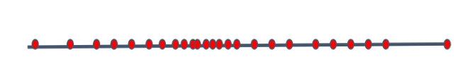
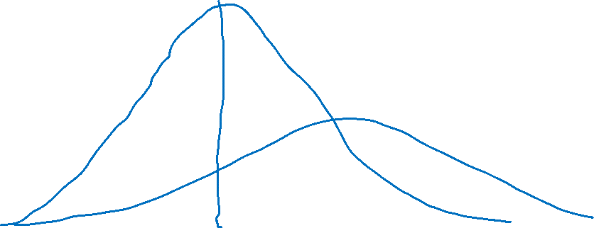
my humble ML course
Likelihood
GOAL: Find the correct distribution of the data.

Slide 8
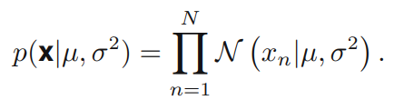
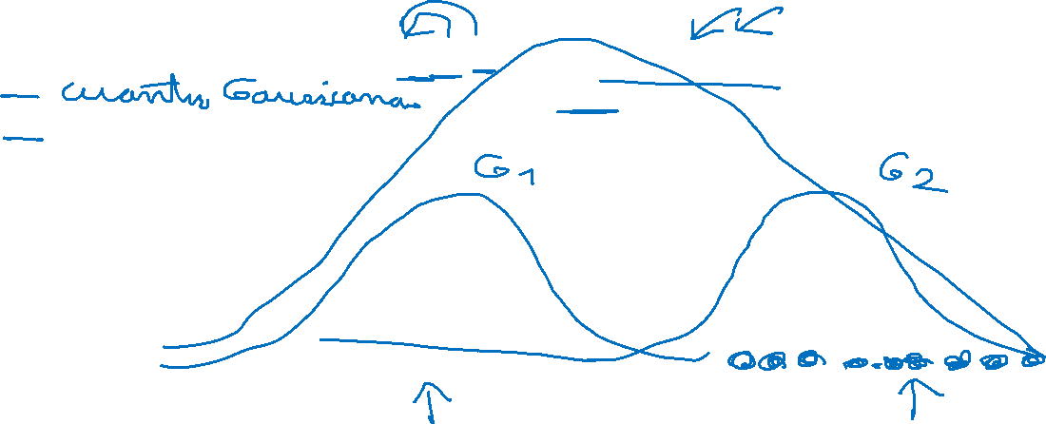
my humble ML course
Likelihood
The likelihood function (often simply called the likelihood) is the joint probability (or probability density) of observed data viewed as a function of the parameters of a statistical model.

Slide 9
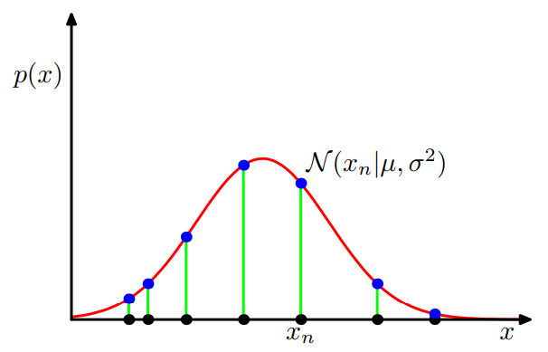
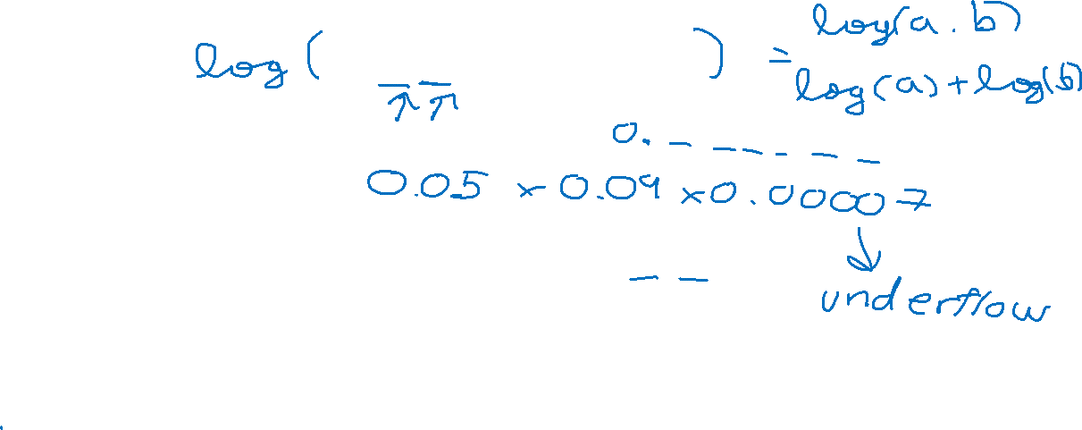
my humble ML course
Likelihood
The likelihood function (often simply called the likelihood) is the joint probability (or probability density) of observed data viewed as a function of the parameters of a statistical model.

Slide 10
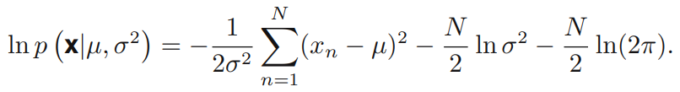
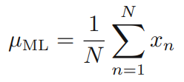
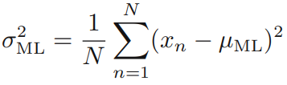
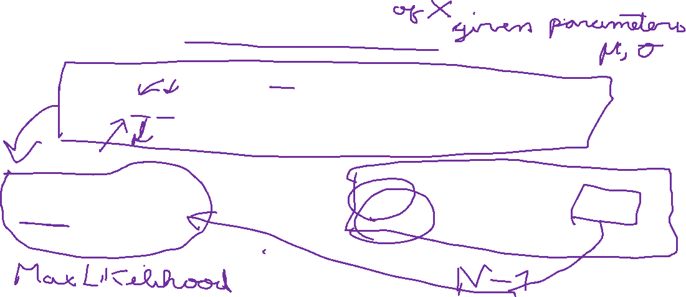
my humble ML course
Log-likelihood
We shall determine values for the unknown parameters µ and σ2 in the Gaussian by maximizing the likelihood function.
In practice, it is more convenient to maximize the log of the likelihood function.

Slide 11
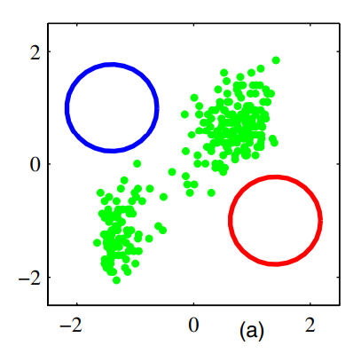
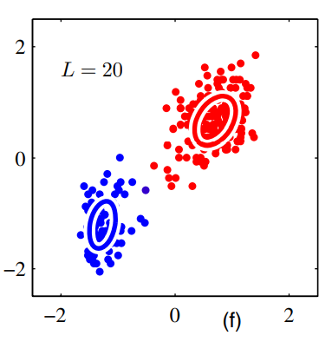

my humble ML course
Mixture of Gaussians
<text>

Slide 12
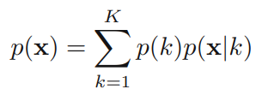
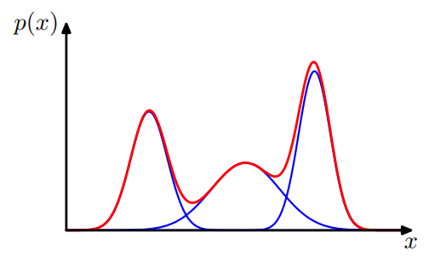
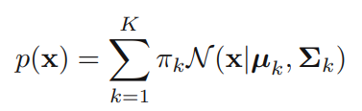
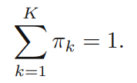

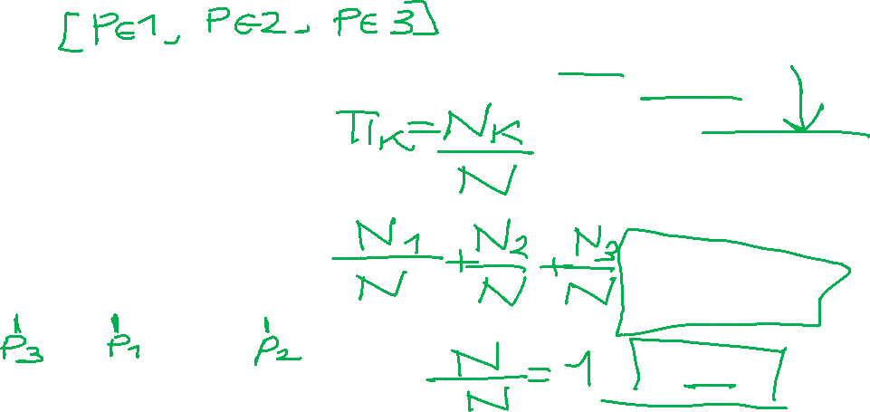
my humble ML course
Mixture of Gaussians
A simple Gaussian distribution is unable to capture this structure, whereas a linear superposition of 2 Gaussians gives a better characterization of the data set.

Slide 13
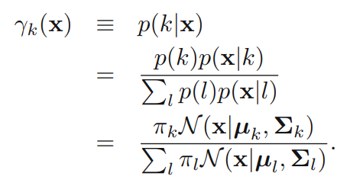
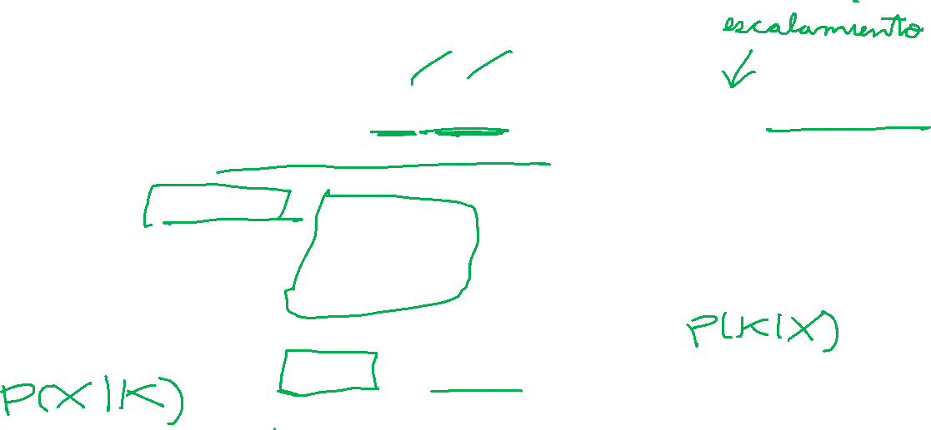
my humble ML course
Mixture of Gaussians
MODEL:
“LOSS FUNCTION “: log-likelihood
CONSTRAINTS:
RESPONSIBILITIES:

Slide 14
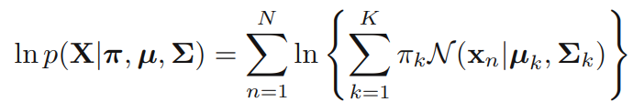

my humble ML course
Log-likelihood of GMM
GOAL: Maximize
LOSS FUNCTION:
CONSTRAINTS:

Slide 15



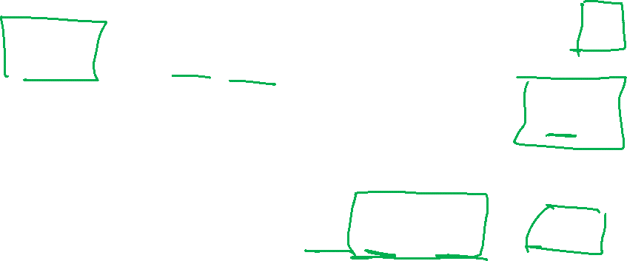
my humble ML course
GMM in terms of discrete latent variables
$z$ is a one-hot encode state vector, there are K possible states.
$z_{n}$is associated with the n-th data point.
$π_{k}$is the proportion of elements belongs to the cluster K.
Notes:
Znk, esta asociado con el punto Xn y el k-esimo cluster

Slide 16
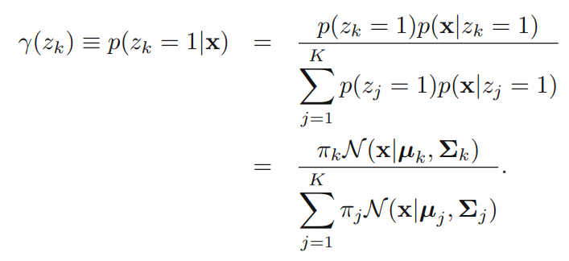
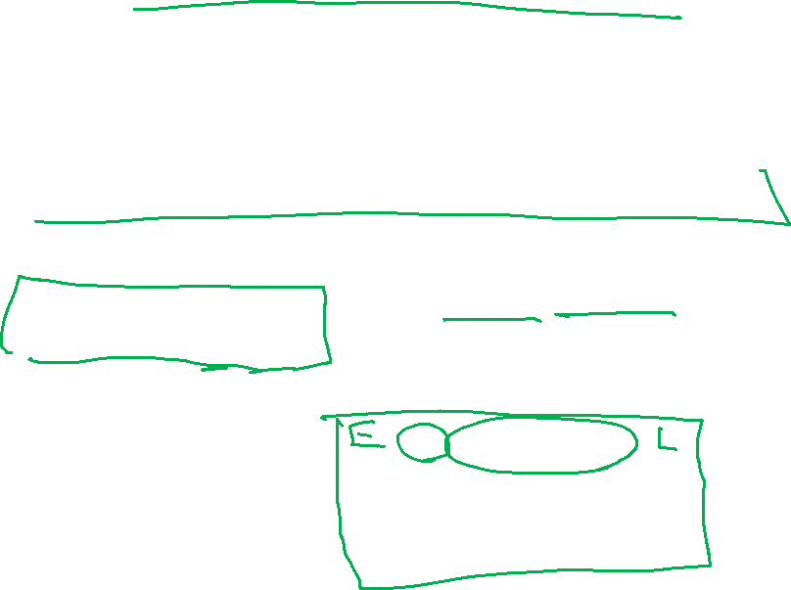
my humble ML course
GMM in terms of discrete latent variables
$z$ is a one-hot encode state vector, there are K possible states.
$z_{n}$is associated with the n-th data point.
$π_{k}$is the proportion of elements belongs to the cluster K.
Notes:
Znk, esta asociado con el punto Xn y el k-esimo cluster
Y(Znk) responsabilidad del cluster K en producir/predecir el n-th punto del dataset

Slide 17
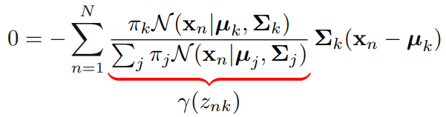
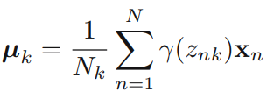
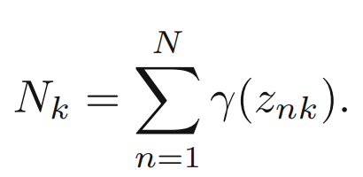
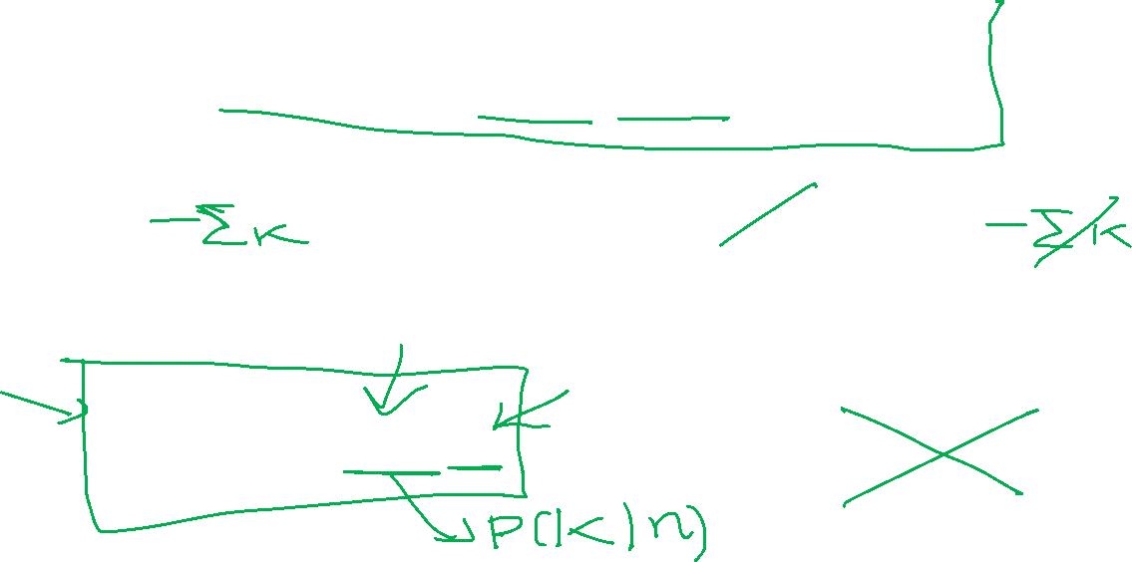
my humble ML course
Derivative framework (= 0)
GOAL: Maximize
with respect to the mean
Notes:
We can interpret Nk as the effective number of points assigned to cluster k.
Note carefully the form of this solution.
We see that the mean µk for the kth Gaussian component is obtained by taking a weighted mean of all of the points in the data set, in which the weighting factor for data point xn is given by the posterior probability γ(znk) that component k was responsible for generating xn.

Slide 18
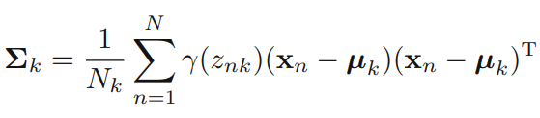
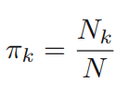
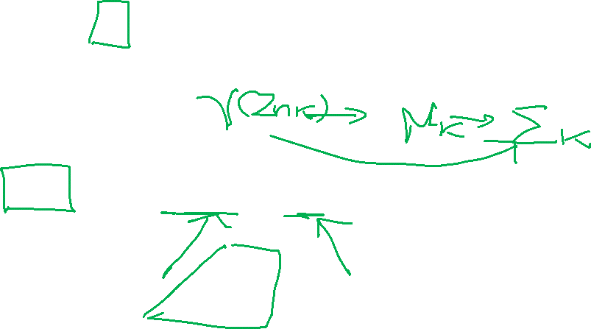
my humble ML course
Derivative framework (= 0)
GOAL: Maximize
with respect to the covariance matrix
with more math we obtain
Notes:
We can interpret Nk as the effective number of points assigned to cluster k.
Note carefully the form of this solution.
We see that the mean µk for the kth Gaussian component is obtained by taking a weighted mean of all of the points in the data set, in which the weighting factor for data point xn is given by the posterior probability γ(znk) that component k was responsible for generating xn.

Slide 19
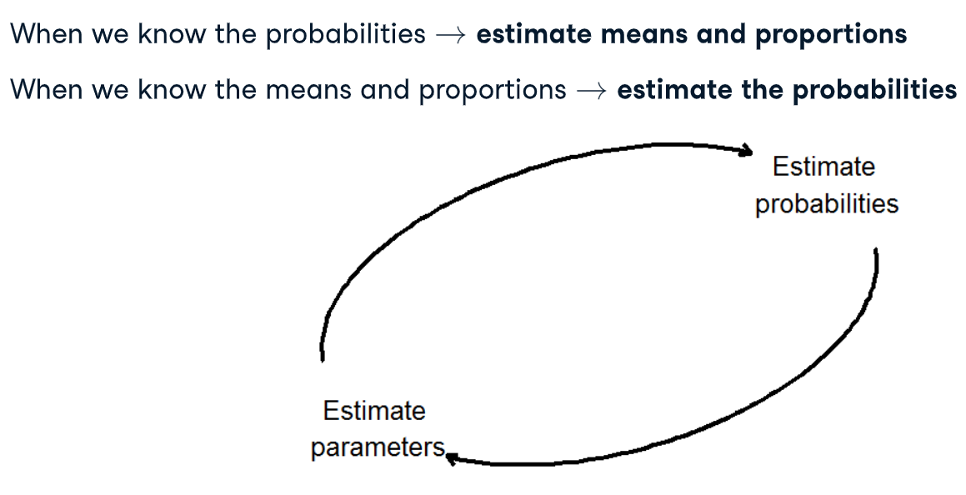

my humble ML course
Expectation-Maximization

Slide 20



my humble ML course
EM algorithm for GMM

Slide 21

my humble ML course
Expectation-Maximization

Slide 22


my humble ML course
GMM
# components?
parameter initialization
model evaluation
why probabilistic models?

Slide 23


my humble ML course
Variational
autoencoder

Slide 24

my humble ML course
Generative networks

Slide 25
my humble ML course
Bibliography
https://stackoverflow.com/questions/59827051/evaluating-gaussian-mixture-model-using-a-score-metric
https://towardsdatascience.com/gaussian-mixture-model-clusterization-how-to-select-the-number-of-components-clusters-553bef45f6e4
https://github.com/Ransaka/GMM-from-scratch/blob/master/GMM%20from%20scratch.ipynb
https://drive.google.com/drive/u/0/folders/1X3AjOQ2G7NZO3U_0KGYzPXex49vx3Iy-
https://www.analyticsvidhya.com/blog/2016/11/an-introduction-to-clustering-and-different-methods-of-clustering/
https://www.jeremyjordan.me/variational-autoencoders/
https://www.kaggle.com/code/artaayaz/animefacedataset-gan-project
https://jakevdp.github.io/PythonDataScienceHandbook/05.12-gaussian-mixtures.html https://github.com/sayaliwalke30/Kaggle-Projects

